Slide 1



OpenShift Enterprise (OSE)
by Anjith Kumar

Slide 2
Agenda
Introduction
PaaS advantages
OSE Versions
Docker Build
Kubernetes
OSE CLI
Deploy Process
Templates
Persistent Volume
Application Health Checks
Application Scaling
REST API Reference
Demo

Slide 3
Introduction
OpenShift Enterprise: A on-premises PaaS geared towards Java and other Linux-based programming and hosting technologies.
OpenShift Enterprise is a PaaS/application hosting platform that empowers developers to rapidly spin up computing environments, tailor them for their needs and quickly integrate them with APIs, databases and middleware while deploying their code through automation.
The platform leverages Docker containers to run Java web applications as well as other modern programming languages like Ruby, Node.js, Python, Ruby, Perl and PHP.
Currently known as OpenShift Container Platform.

Slide 4
Advantages
Faster deployments and faster time to market
Streamlined Application Management
Reduced Complexity and Increased Agility
Lower Costs and Higher Computing Efficiency
Efficient Scalability
More Predictable Environment

Slide 5
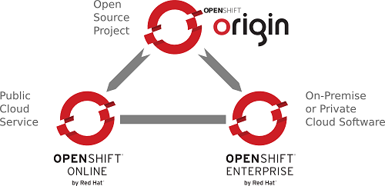
Versions of RedHat OpenShift
OpenShift Origin : The free & open source version of OpenShift
OpenShift Online : Hosted on Red Hat, its available over the internet with Free & Paid plans to build & deploy personal Applications.
OpenShift Enterprise :Enterprise cloud implementation on In-House data center, gives full features of OpenShift with Sys-Admins to have control on the Infrastructure.
Challenges
ion
Results

Slide 6
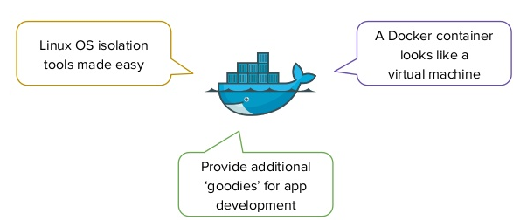
Docker
Platform for developing, shipping & running applications using container virtualization technology.
A container is a stripped-to-basics version of a Linux operating system. An image is software you load into a container.
Docker images is a packaging technology.
Application would be bundled as an image which would be deployed on the OSE v3

Slide 7
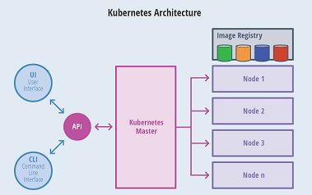
Kubernetes
Kubernetes is the industry leading open source container orchestration framework.
Google project that OSE V3 uses to manage containers.
Provides mechanism to deploy, maintain and scale applications. Provides the cluster management and orchestrates containers on multiple hosts
Has components to load balance.

Slide 8
Docker Build
Docker build strategies
Docker Build : Builds docker images from a Dockerfile and a ‘context’. A Build’s context is the files located in the specified PATH.
Source-to-Image (S2I) Build: Produces ready-to-run images by injecting application source into a Docker image and assembling a new Docker image. New image incorporates the base image (the builder) and built source and is ready to use with the docker run command.
Docker Registry
A Docker registry is a service for storing and retrieving Docker images.
A registry contains a collection of one or more Docker image repositories. And each repository contains one or more tagged images
Optum has own registry to store and manage Docker images
https://docker.optum.com

Slide 9
OSE Terminology
Pod:
Smallest compute unit that can be defined, deployed, and managed.
A Pod holds one or more Docker containers together.
Scaling is achieved by running multiple instances of a Pod.
OpenShift treats pods as largely immutable; changes cannot be made to a pod definition while it is running.
Service:
A Service is a method to group and load balance.
Replication Controller:
A replication controller ensures that a specified number of replicas of a pod are running at all times.
If pods exit or are deleted, the replica controller acts to instantiate more up to the desired number.
Route
An OpenShift route is a way to expose a service by giving it an externally-reachable hostname

Slide 10
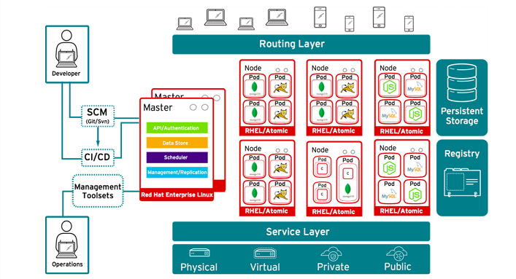
OpenShift Architecture

Slide 11

OpenShift CLI
The OpenShift CLI exposes commands for managing your applications and tools to interact with each component within OSE.
Authorization is handled in the OpenShift policy engine.
The developer CLI uses the oc command, which is used for project-level operations.
The administrator CLI uses the oadm command for more advanced, administrator operations.
OpenShift CLI tool can be requited via appstore.

Slide 12
OpenShift CLI commands
Generic OC command instruction format
# oc <action> <object_type> <object_name_or_id>
Create a project
# oc new-project hello-world --description="This is an example project" --display-name="Hello World“
Switch Project
# oc project hello-world
Create new application
# oc new-app --docker-image=docker.optum.com/repo-name/image-name --name=application name

Slide 13
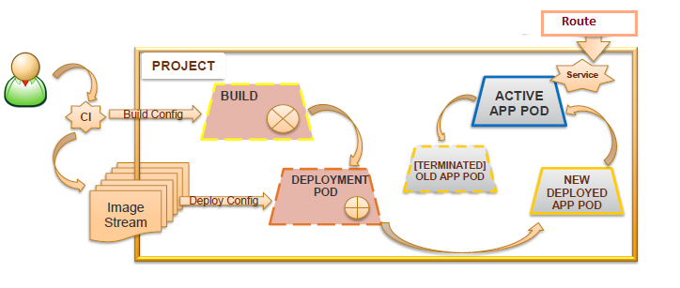
Deploy

Slide 14
Templates
A template describes a set of objects that can be parameterized and processed to produce a list of objects for creation by OpenShift Enterprise.
The objects to create can include anything that users have permission to create within a project, for example services, build configurations and deployment configurations.
Users can define their own templates within their own projects.
Usage:
Diving right in once you are in your project:
$ oc export all --as-template=mytemplate >> mytemplate.yml
To upload a template to your current project’s template library, pass the JSON or YAML file with the following command:
$ oc create –f mytemplate.yml

Slide 15
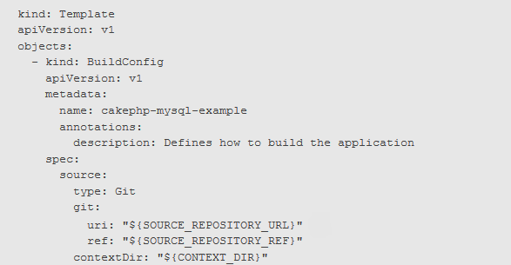
Template Parameters
Templates allow you to define parameters which take on a value. That value is then substituted wherever the parameter is referenced.
parameters:
- description: The name of your environment.
name: NAME
required: true
value: microemr-dev

Slide 16
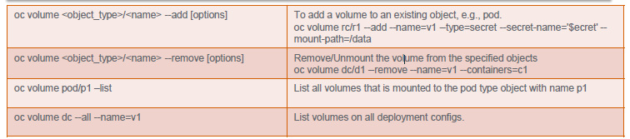
Persistent Volumes
Containers are not persistent by default; on restart, their contents are cleared.
A PersistentVolume object is a storage resource in an OpenShift Enterprise cluster. Storage is provisioned by your cluster administrator by creating PersistentVolume objects from sources such as NFS mounts.
A PersistentVolume is a specific resource. A PersistentVolumeClaim is a request for a resource with specific attributes, such as storage size.

Slide 17
Health Checks Using Probes
OpenShift Enterprise applications have a option to detect and handle unhealthy containers.
A probe is a Kubernetes action that periodically performs diagnostics on a running container
Currently, two types of probes exist, each serving a different purpose:
Readiness Probe - A readiness probe determines if a container is ready to service requests.
Liveness Probe - A liveness probe checks if the container in which it is configured is still running. If the liveness probe fails, the kubernetes kills the container, which will be subjected to its restart policy.
Both probes can be configured in three ways:
HTTP Checks - Uses a web hook to determine the healthiness of the container.
Container Execution Checks - Executes a command inside the container.
TCP Socket Checks - Kubelet attempts to open a socket to the container.

Slide 18
Application Scaling
Application scaling enables your application to react to changes in traffic and automatically allocate the necessary resources to handle your current demand.
- Vertical Scaling – Moving to containers with high resources
- Horizontal Scaling – Running more pods.
In cloud hosting such as a PaaS, main scaling strategy should shifted to horizontal scaling.
Manual Horizontal Scaling : Spin up another pod manually using OSE web
Console/CLI
Auto Horizontal Scaling: Specifies how the system should automatically increase or decrease the scale of a replication controller or deployment configuration, based on metrics collected from the pods that belong to that replication controller or deployment configuration.

Slide 19
REST API Reference
The OpenShift Enterprise distribution of Kubernetes includes the Kubernetes v1 REST API and the OpenShift v1 REST API. These are RESTful APIs accessible via HTTP(s) on the OpenShift Enterprise master servers.
These REST APIs can be used to manage end-user applications, the cluster, and the users of the cluster.

Slide 20
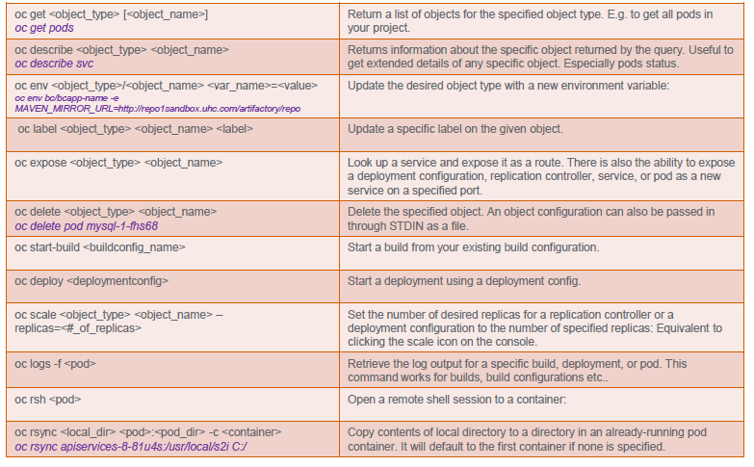
OSE CLI Commands

Slide 21
Demo
Dockerfile walkthrough
Create Image
Push Image to repository
Optum Docker registry
Start new deployment
Deploy updated image
Update Deployment Config
Create route
View pod logs
Access container terminal

Slide 22
References :
https://docs.openshift.com/enterprise/3.2/welcome/index.html
https://www.optumdeveloper.com/content/odv-optumdev/optum-developer/en/developer-centers/paas-developer-center/devops-java--openshift-enterprise-/openshift-v3-technical-resources.html
Challenges
ion
Results

Slide 23
Thank You

